Slide 1
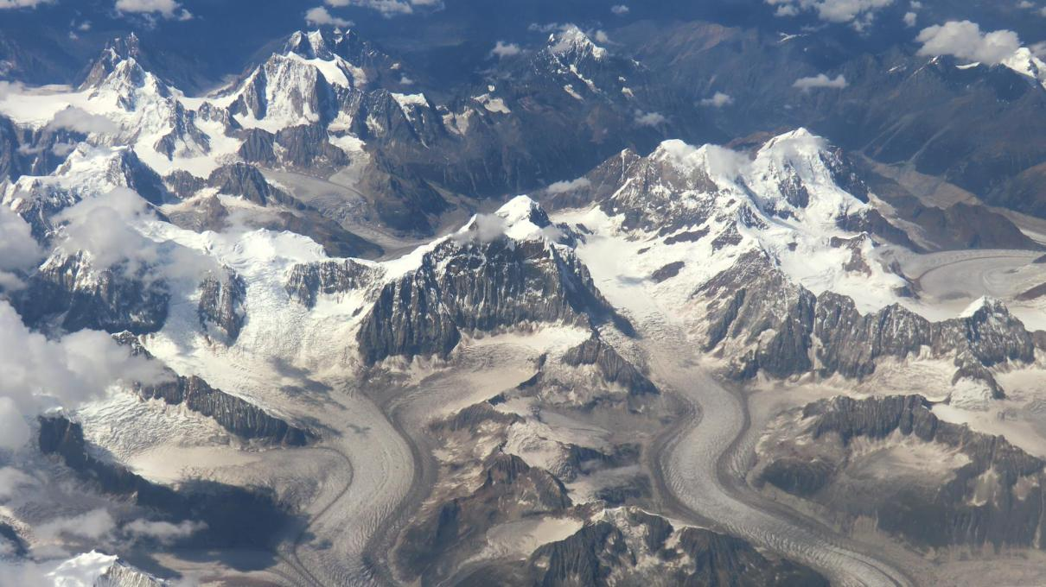

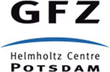
Multidisciplinary approach to assess thermo-mechanical properties of the Asian lithosphere
Ward Stolk^{1,2}, Mikhail Kaban², Magdala Tesauro², Fred Beekman¹, Sierd Cloetingh¹
¹ Utrecht University (w.stolk@uu.nl), ²GeoForschungsZentrum Potsdam
Assessing the thermo-mechanical properties of the lithospheric mantle still poses many problems. Seismic studies indicate large heterogeneities within the mantle lithosphere, but cannot discern between e.g. thermal and compositional effects. Analysis of the only gravity anomalies cannot constrain density heterogeneities. A joint analysis of both data types potentially leads to an improved insight in the mantle lithosphere, though the solution to the problem at hand remains non-unique and additional constraints are required.
Tomography model
Gravity Anomalies
1/4
Thermal Modelling
Forward Gravity Modelling
Analyse Gravity
Anomaly Difference
Update Composition

Slide 2
Multidisciplinary approach to assess thermo-mechanical properties of the Asian lithosphere
Ward Stolk^{1,2}, Mikhail Kaban², Magdala Tesauro², Fred Beekman¹, Sierd Cloetingh¹
¹ Utrecht University (w.stolk@uu.nl), ²GeoForschungsZentrum Potsdam
We have combined a high resolution tomography model with a recent global gravity anomaly model to improve our knowledge of both the compositional and thermal aspects of the mantle lithosphere in the Asian continent. The preliminary results presented here will focus on the four major cratonic areas in Asia: the East European Platform, Siberia, Northeast China and India. These regions represent two distinct types of cratonic lithosphere (deep root and shallow root).
Tomography model
Gravity Anomalies
2/4
Thermal Modelling
Forward Gravity Modelling
Analyse Gravity
Anomaly Difference
Update Composition

Slide 3
Multidisciplinary approach to assess thermo-mechanical properties of the Asian lithosphere
Ward Stolk^{1,2}, Mikhail Kaban², Magdala Tesauro², Fred Beekman¹, Sierd Cloetingh¹
¹ Utrecht University (w.stolk@uu.nl), ²GeoForschungsZentrum Potsdam
This study uses an iterative approach, the workflow of which is outlined on this slide. Based on a tomography model, first a temperature and density model are determined. The density model is transformed into a gravity anomaly model using forward gravity modelling. These modelled gravity anomalies can be compared to observed gravity anomalies. Differences between the two can be used determine where compositional changes need to be applied in the thermal-density modelling. The proces converges quickly, four iterations are more than sufficient.
Tomography model
Gravity Anomalies
3/4
Thermal Modelling
Forward Gravity Modelling
Analyse Gravity
Anomaly Difference
Update Composition

Slide 4
Multidisciplinary approach to assess thermo-mechanical properties of the Asian lithosphere
Ward Stolk^{1,2}, Mikhail Kaban², Magdala Tesauro², Fred Beekman¹, Sierd Cloetingh¹
¹ Utrecht University (w.stolk@uu.nl), ²GeoForschungsZentrum Potsdam
You are kindly invited to click on the different steps outlined on this slide to obtain more information on that particular subject. The results of each step, and each iteration, are presented in those explanations as well. Figures can be enlarged by clicking on that figure. Clicking the title banner on top of a slide will always bring you back to the first slide.
Tomography model
Gravity Anomalies
4/4
Thermal Modelling
Forward Gravity Modelling
Analyse Gravity
Anomaly Difference
Update Composition

Slide 5
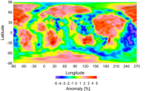
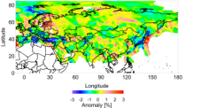
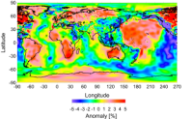
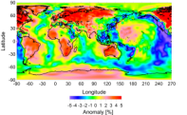
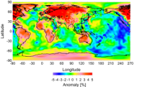
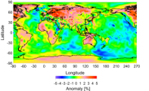
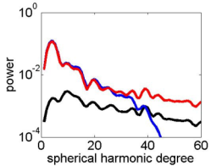
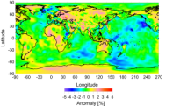
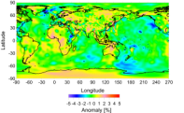
Multidisciplinary approach to assess thermo-mechanical properties of the Asian lithosphere
Ward Stolk^{1,2}, Mikhail Kaban², Magdala Tesauro², Fred Beekman¹, Sierd Cloetingh¹
¹ Utrecht University (w.stolk@uu.nl), ²GeoForschungsZentrum Potsdam
X
+
=
Tomography model
50km
Gravity Disturbances
S40
Koulakov
100km
The shear wave anomaly model used as input is a combination of the world wide S40RTS model (Ritsema et al. 2011) and a regional high resolution model provided by Koulakov (pers. comm.). Spectral analysis of the two models reveals that the regional model underestimates the amplitudes of the anomalies. Furthermore, the long wavelengths (>2000km) are underrepresented in the regional model. The global model on the other hand is truncated at degree 40 (1000km wavelength) and lacks short wavelength signal (see figure on the left). In combining both models, a low-pass filter has been applied to the global model and a high-pass filter has been applied to the regional model. Furthermore, the amplitudes in the regional model have been increased to represent those in the global model for mid-range wavelengths.
S40
Koulakov
Combined
Thermal Modelling
Forward Gravity Modelling
Analyse Gravity
Disturbance Difference
150km
200km
Update Composition
Spectral analysis
250km
300km

Slide 6
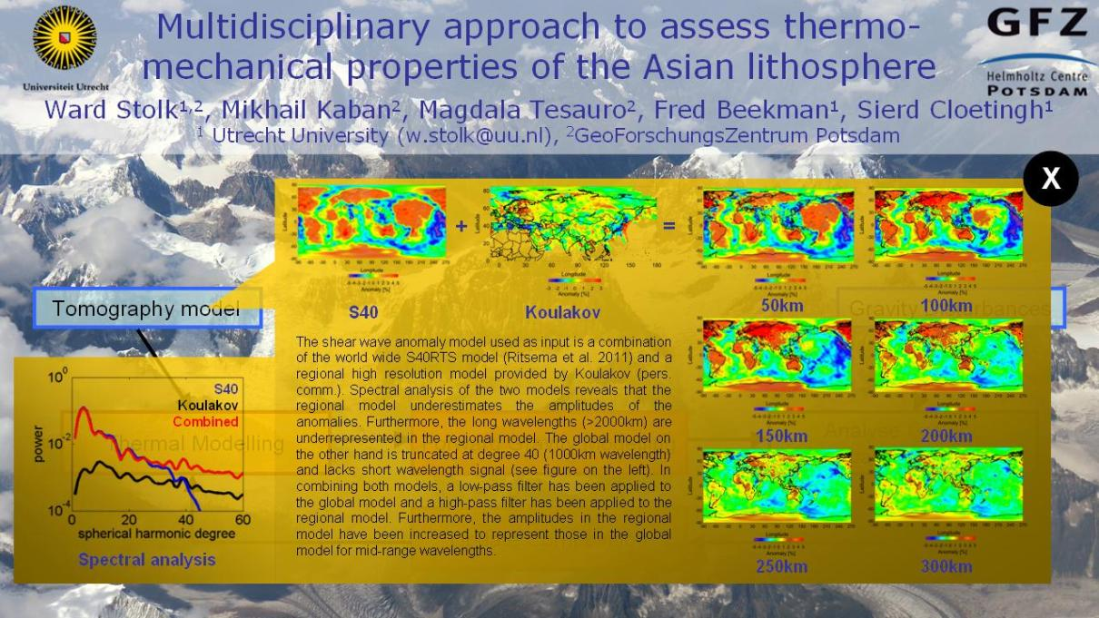
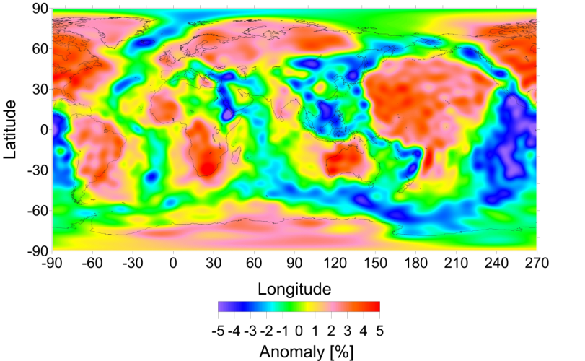
S40 Vs-anomaly @ 50km
X

Slide 7
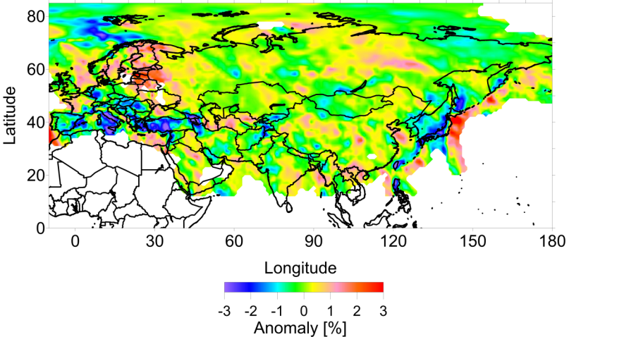
Koulakov @ 50km
X

Slide 8
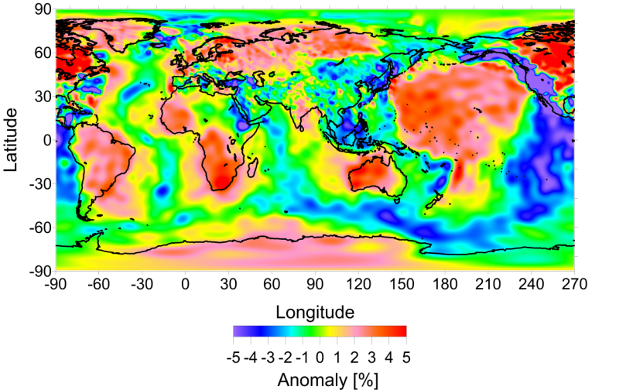
Combined Vs-anomaly @ 50km
X

Slide 9
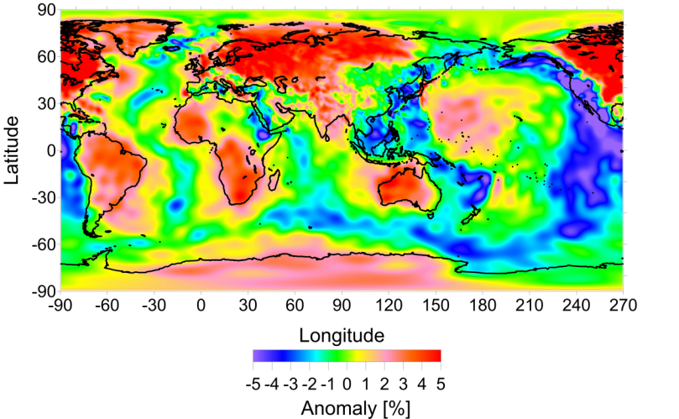
Combined Vs-anomaly @ 100km
X

Slide 10

Combined Vs-anomaly @ 150km
X

Slide 11
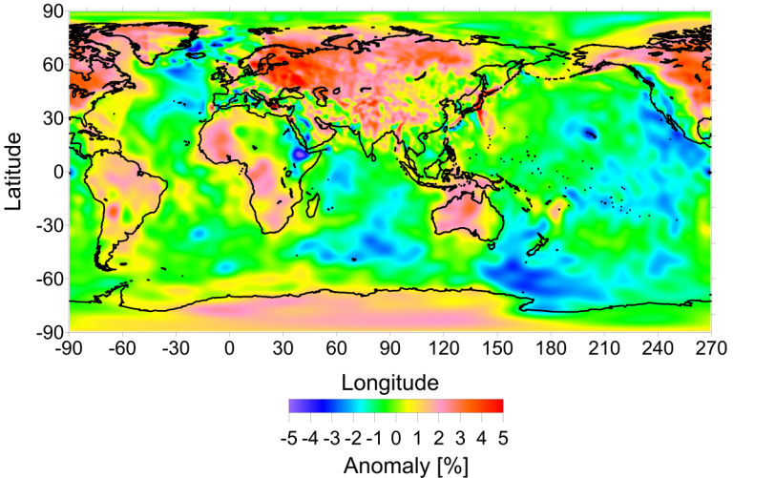
Combined Vs-anomaly @ 200km
X

Slide 12
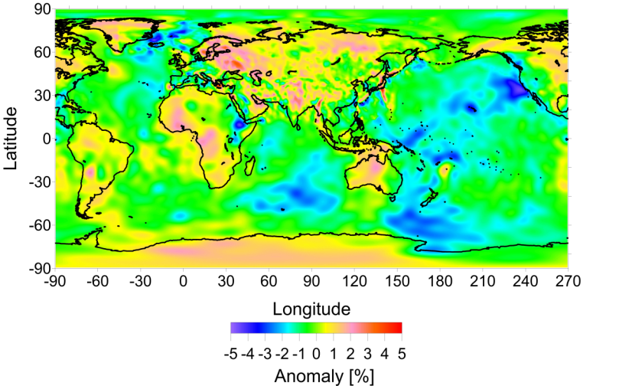
Combined Vs-anomaly @ 250km
X

Slide 13

Combined Vs-anomaly @ 300km
X

Slide 14
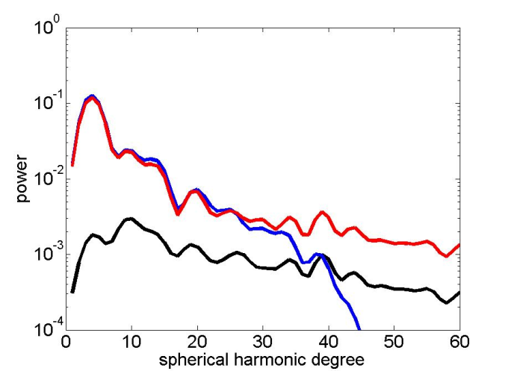
Spectral analysis
X

Slide 15
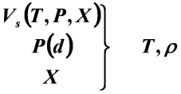
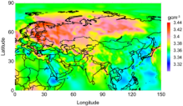
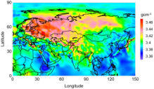
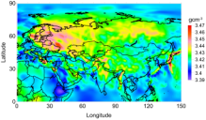
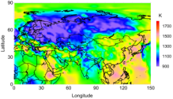
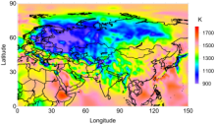
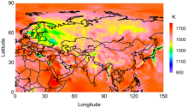
Multidisciplinary approach to assess thermo-mechanical properties of the Asian lithosphere
Ward Stolk^{1,2}, Mikhail Kaban², Magdala Tesauro², Fred Beekman¹, Sierd Cloetingh¹
¹ Utrecht University (w.stolk@uu.nl), ²GeoForschungsZentrum Potsdam
X
Shear wave velocities (Vs) are a function of temperature (T), pressure (P) and composition (X). Following the relations in Goes et al. (2000), and Cammarano (2003), T and ρ can be obtained from Vs. In the first iteration a general composition is used uniformly throughout the upper mantle. Resulting T and density anomalies (Δρ) can be seen to the right.
Tomography model
Gravity Disturbances
100km
150km
200km
Δρ
Thermal Modelling
Forward Gravity Modelling
Analyse Gravity
Disturbance Difference
T
Update Composition
Iteration 1

Slide 16
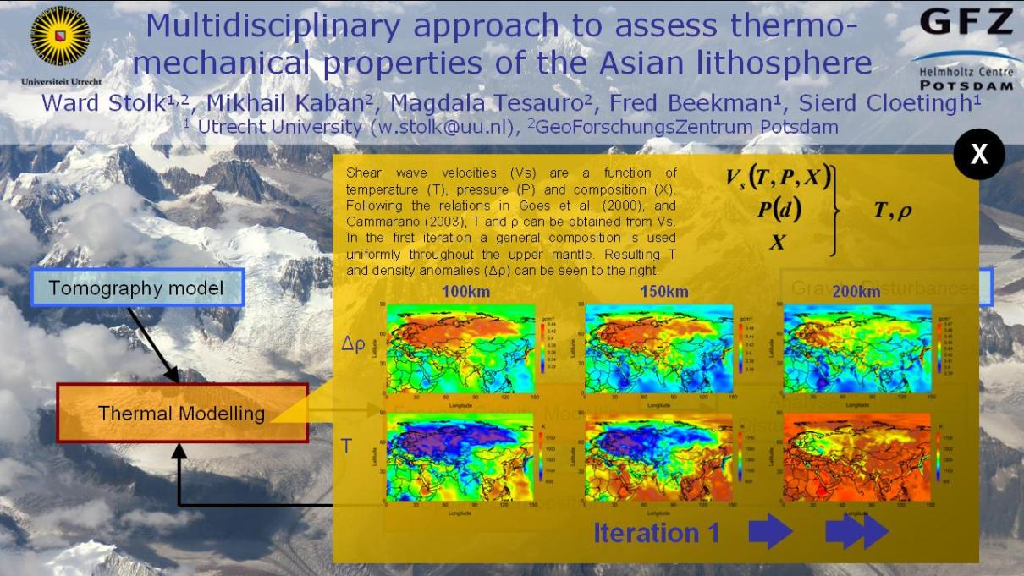
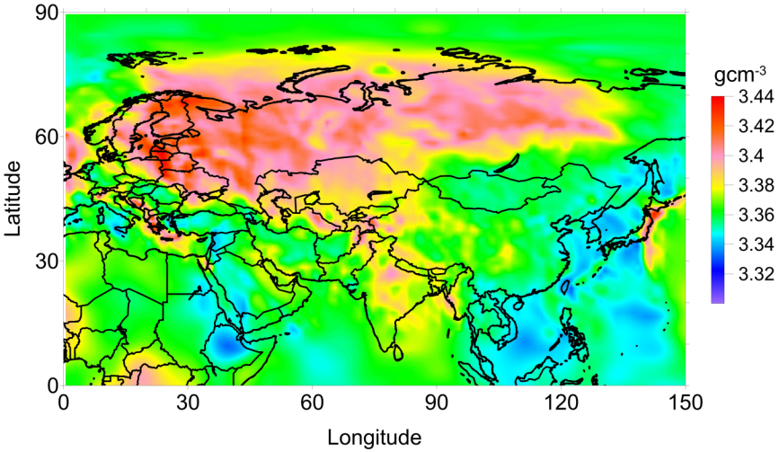
Δρ, iteration 1 @ 100km
X

Slide 17
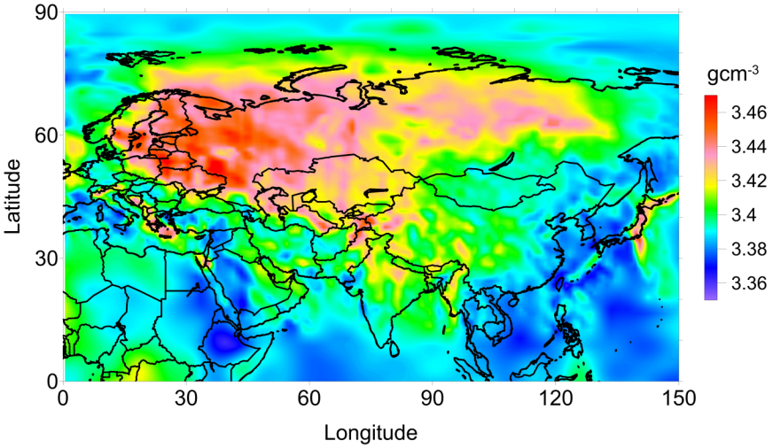
Δρ, iteration 1 @ 150km
X

Slide 18
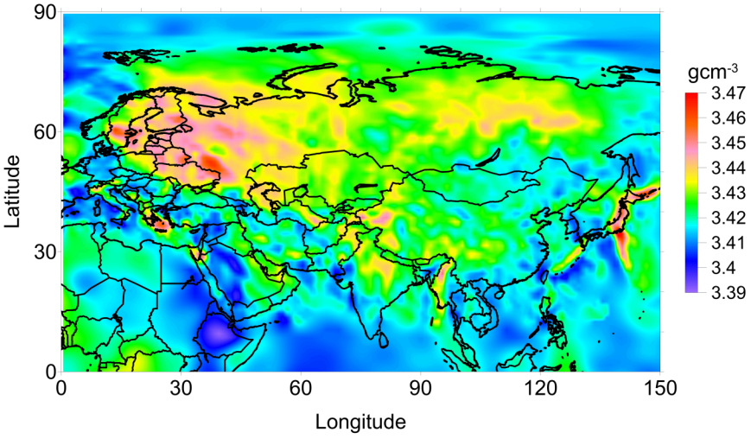
Δρ, iteration 1 @ 200km
X

Slide 19
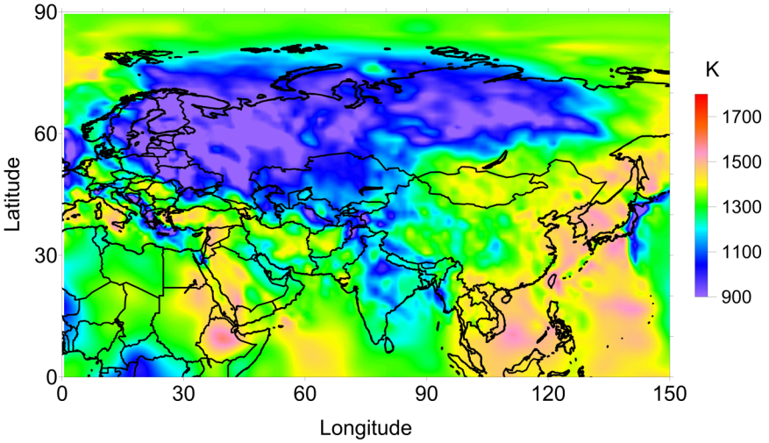
T, iteration 1 @ 100km
X

Slide 20
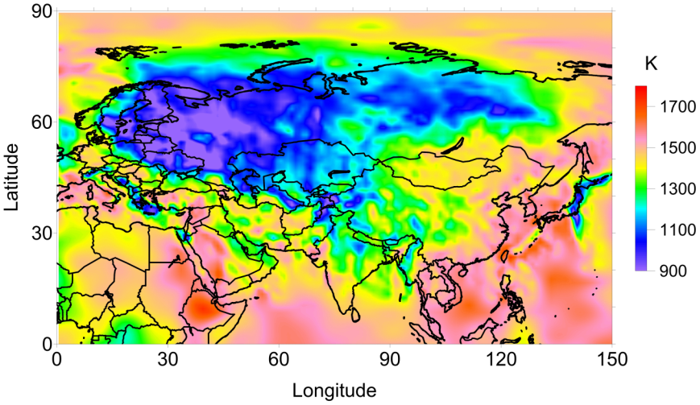
T, iteration 1 @ 150km
X

Slide 21
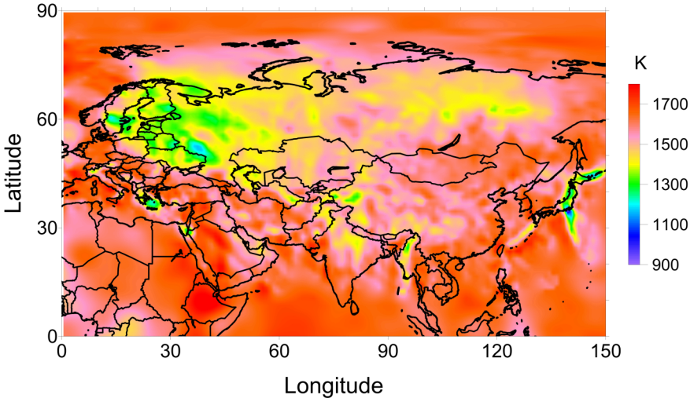
T, iteration 1 @ 200km
X

Slide 22
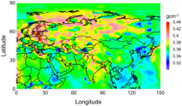
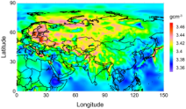
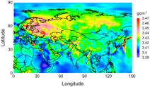
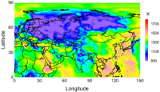
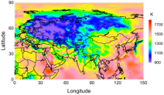
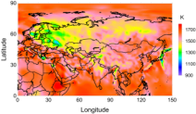
Multidisciplinary approach to assess thermo-mechanical properties of the Asian lithosphere
Ward Stolk^{1,2}, Mikhail Kaban², Magdala Tesauro², Fred Beekman¹, Sierd Cloetingh¹
¹ Utrecht University (w.stolk@uu.nl), ²GeoForschungsZentrum Potsdam
X
Shear wave velocities (Vs) are a function of temperature (T), pressure (P) and composition (X). Following the relations in Goes et al. (2000), and Cammarano (2003), T and ρ can be obtained from Vs. In the first iteration a general composition is used uniformly throughout the upper mantle. Resulting T and density anomalies (Δρ) can be seen to the right.
Tomography model
Gravity Disturbances
100km
150km
200km
Δρ
Thermal Modelling
Forward Gravity Modelling
Analyse Gravity
Disturbance Difference
T
Update Composition
Iteration 2

Slide 23
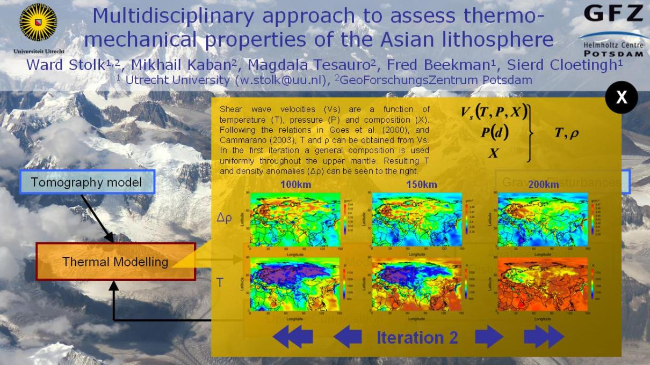
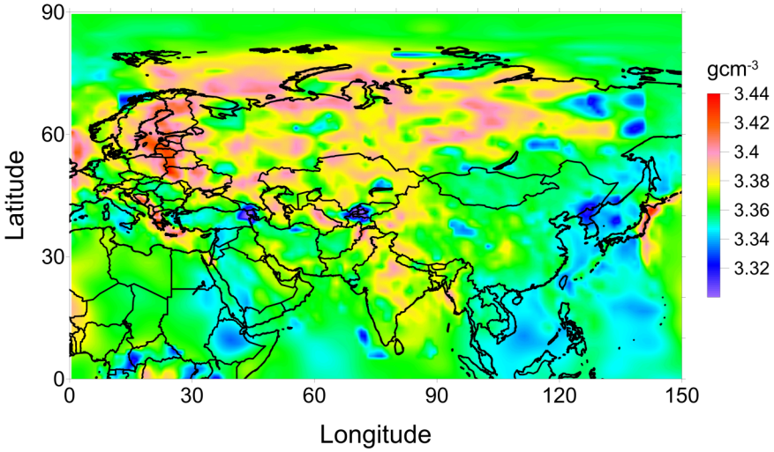
Δρ, iteration 2 @ 100km
X

Slide 24
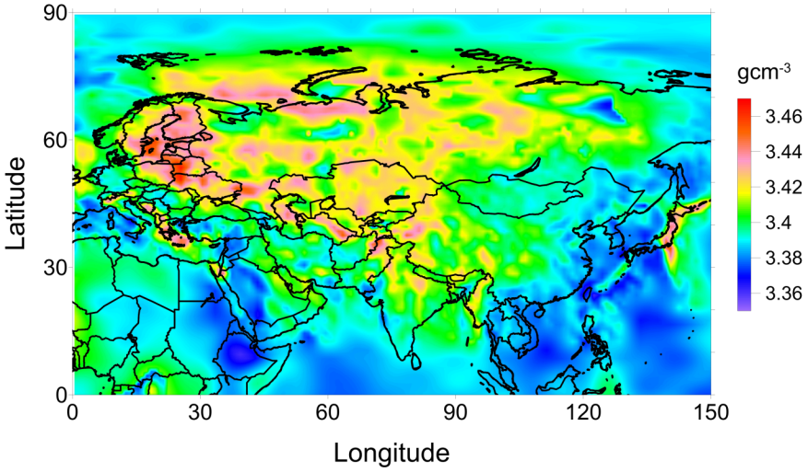
Δρ, iteration 2 @ 150km
X

Slide 25
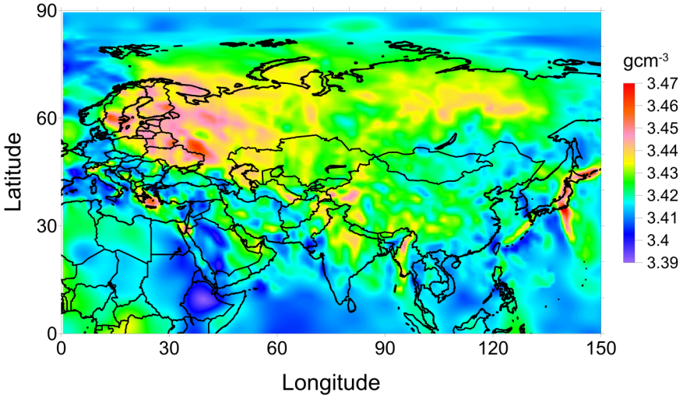
Δρ, iteration 2 @ 200km
X

Slide 26

T, iteration 2 @ 100km
X

Slide 27
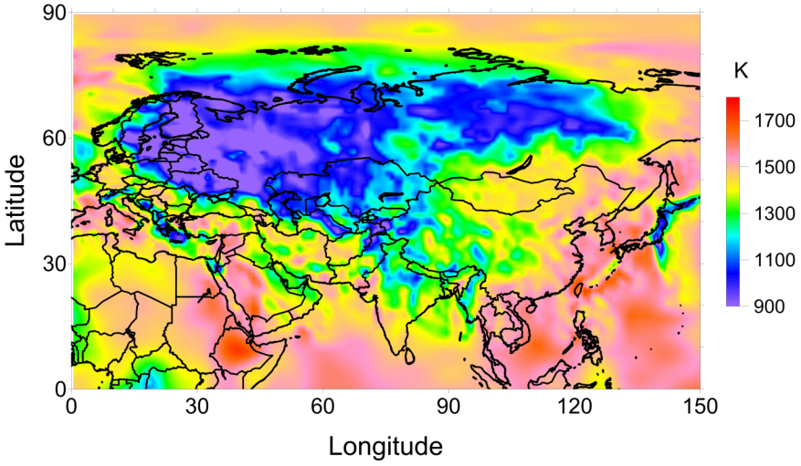
T, iteration 2 @ 150km
X

Slide 28
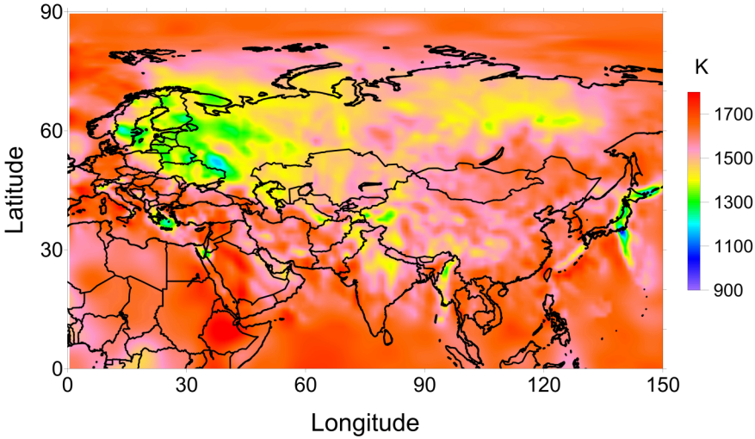
T, iteration 2 @ 200km
X

Slide 29
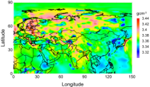
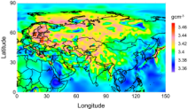
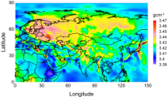

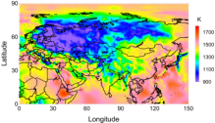
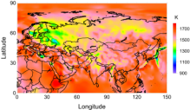
Multidisciplinary approach to assess thermo-mechanical properties of the Asian lithosphere
Ward Stolk^{1,2}, Mikhail Kaban², Magdala Tesauro², Fred Beekman¹, Sierd Cloetingh¹
¹ Utrecht University (w.stolk@uu.nl), ²GeoForschungsZentrum Potsdam
X
Shear wave velocities (Vs) are a function of temperature (T), pressure (P) and composition (X). Following the relations in Goes et al. (2000), and Cammarano (2003), T and ρ can be obtained from Vs. In the first iteration a general composition is used uniformly throughout the upper mantle. Resulting T and density anomalies (Δρ) can be seen to the right.
Tomography model
Gravity Disturbances
100km
150km
200km
Δρ
Thermal Modelling
Forward Gravity Modelling
Analyse Gravity
Disturbance Difference
T
Update Composition
Iteration 3

Slide 30


Δρ, iteration 3 @ 100km
X

Slide 31

Δρ, iteration 3 @ 150km
X

Slide 32

Δρ, iteration 3 @ 200km
X

Slide 33

T, iteration 3 @ 100km
X

Slide 34

T, iteration 3 @ 150km
X

Slide 35

T, iteration 3 @ 200km
X

Slide 36






Multidisciplinary approach to assess thermo-mechanical properties of the Asian lithosphere
Ward Stolk^{1,2}, Mikhail Kaban², Magdala Tesauro², Fred Beekman¹, Sierd Cloetingh¹
¹ Utrecht University (w.stolk@uu.nl), ²GeoForschungsZentrum Potsdam
X
Shear wave velocities (Vs) are a function of temperature (T), pressure (P) and composition (X). Following the relations in Goes et al. (2000), and Cammarano (2003), T and ρ can be obtained from Vs. In the first iteration a general composition is used uniformly throughout the upper mantle. Resulting T and density anomalies (Δρ) can be seen to the right.
Tomography model
Gravity Disturbances
100km
150km
200km
Δρ
Thermal Modelling
Forward Gravity Modelling
Analyse Gravity
Disturbance Difference
T
Update Composition
Iteration 4

Slide 37


Δρ, iteration 4 @ 100km
X

Slide 38

Δρ, iteration 4 @ 100km
X

Slide 39

Δρ, iteration 4 @ 200km
X

Slide 40

T, iteration 4 @ 100km
X

Slide 41

T, iteration 4 @ 150km
X

Slide 42

T, iteration 1 @ 200km
X

Slide 43




Multidisciplinary approach to assess thermo-mechanical properties of the Asian lithosphere
Ward Stolk^{1,2}, Mikhail Kaban², Magdala Tesauro², Fred Beekman¹, Sierd Cloetingh¹
¹ Utrecht University (w.stolk@uu.nl), ²GeoForschungsZentrum Potsdam
X
The gravitational potential of a collection of masses is the sum of the gravitational attractions of the individual masses (eq. 1). This equation can be approached by a numerical sum over a finite number of bodies with a constant density (ρ) multiplied by the volume integral over that body (ψ) (eq. 2). Fortunately, the integral over ψ is easily evaluated for two simple bodies, a parallelepiped (fig. A.) and a sector zone (fig. B).
Volume elements close (within 3 degrees) to the evaluation point (m) are replaced by a parallelepiped with the same mass and the same center of mass. Volume elements farther away are replaced with sector zones, again with the same mass and center of mass as the original volume element. All in all, the inaccuracy due to approximation stays within 1mGal.
A
B
1
Tomography model
2
Gravity Disturbances
Thermal Modelling
Forward Gravity Modelling
Analyse Gravity
Anomaly Difference
Update Composition

Slide 44

Multidisciplinary approach to assess thermo-mechanical properties of the Asian lithosphere
Ward Stolk^{1,2}, Mikhail Kaban², Magdala Tesauro², Fred Beekman¹, Sierd Cloetingh¹
¹ Utrecht University (w.stolk@uu.nl), ²GeoForschungsZentrum Potsdam
X
The modelled gravity anomaly, obtained through forward gravity modelling of the mantle density model can be compared with the residual mantle gravity anomaly obtained by subtracting from the observed gravity anomaly [Foerste et al. 2011] the gravity signal of the crust. Thus areas with a mass-deficit turn up blue, whereas areas with a mass-surpluss are red. It can be seen in iteration 1 that large cratonic areas such as the Siberian craton and the East European Platform show a mass deficit, presumably caused by a depleted cratonic root. Cratonic araes in northeast China and India do not show this mass deficit, suggesting the lack of a cratonic root in these areas [e.g. Griffin et Al. 1998, Zheng et Al, 1998].
Tomography model
Gravity Anomalies
Thermal Modelling
Forward Gravity Modelling
Analyse Gravity
Anomaly Difference
Iteration 1
Update Composition

Slide 45


Gravity anomaly difference,
iteration 1
X

Slide 46

Multidisciplinary approach to assess thermo-mechanical properties of the Asian lithosphere
Ward Stolk^{1,2}, Mikhail Kaban², Magdala Tesauro², Fred Beekman¹, Sierd Cloetingh¹
¹ Utrecht University (w.stolk@uu.nl), ²GeoForschungsZentrum Potsdam
X
The modelled gravity anomaly, obtained through forward gravity modelling of the mantle density model can be compared with the residual mantle gravity anomaly obtained by subtracting from the observed gravity anomaly [Foerste et al. 2011] the gravity signal of the crust. Thus areas with a mass-deficit turn up blue, whereas areas with a mass-surpluss are red. It can be seen in iteration 1 that large cratonic areas such as the Siberian craton and the East European Platform show a mass deficit, presumably caused by a depleted cratonic root. Cratonic araes in northeast China and India do not show this mass deficit, suggesting the lack of a cratonic root in these areas [e.g. Griffin et Al. 1998, Zheng et Al, 1998].
Tomography model
Gravity Anomalies
Thermal Modelling
Forward Gravity Modelling
Analyse Gravity
Anomaly Difference
Iteration 2
Update Composition

Slide 47


Gravity anomaly difference,
iteration 2
X

Slide 48

Multidisciplinary approach to assess thermo-mechanical properties of the Asian lithosphere
Ward Stolk^{1,2}, Mikhail Kaban², Magdala Tesauro², Fred Beekman¹, Sierd Cloetingh¹
¹ Utrecht University (w.stolk@uu.nl), ²GeoForschungsZentrum Potsdam
X
The modelled gravity anomaly, obtained through forward gravity modelling of the mantle density model can be compared with the residual mantle gravity anomaly obtained by subtracting from the observed gravity anomaly [Foerste et al. 2011] the gravity signal of the crust. Thus areas with a mass-deficit turn up blue, whereas areas with a mass-surpluss are red. It can be seen in iteration 1 that large cratonic areas such as the Siberian craton and the East European Platform show a mass deficit, presumably caused by a depleted cratonic root. Cratonic araes in northeast China and India do not show this mass deficit, suggesting the lack of a cratonic root in these areas [e.g. Griffin et Al. 1998, Zheng et Al, 1998].
Tomography model
Gravity Anomalies
Thermal Modelling
Forward Gravity Modelling
Analyse Gravity
Anomaly Difference
Iteration 3
Update Composition

Slide 49


Gravity anomaly difference,
iteration 3
X

Slide 50


Multidisciplinary approach to assess thermo-mechanical properties of the Asian lithosphere
Ward Stolk^{1,2}, Mikhail Kaban², Magdala Tesauro², Fred Beekman¹, Sierd Cloetingh¹
¹ Utrecht University (w.stolk@uu.nl), ²GeoForschungsZentrum Potsdam
X
A
Satellite gravity missions in the last decade have observed the Earth’s gravity anomalies with unprecedented detail. Maps regarding the gravity anomalies are taken published by e.g.Foerste et al. [2011] (figure A). The gravity anomaly produced by the crust can be obtained by applying forward gravity modelling to a model of crustal densities [Stolk et al. 2013]. Subtracting the gravity anomaly produced by the crust from the observed gravity anomaly procudes the residual mantle gravity anomaly (figure B). These anomalies can be caused by thermal and compositional heterogeneities in the lithospheric mantle.
Tomography model
Gravity Anomalies
B
Thermal Modelling
Forward Gravity Modelling
Analyse Gravity
Anomaly Difference
Update Composition

Slide 51


Observed Gravity Anomaly
EIGEN-6C (Foerste et Al. 2011)
X

Slide 52

Residual Mantle Gravity Anomaly
X

Slide 53



Multidisciplinary approach to assess thermo-mechanical properties of the Asian lithosphere
Ward Stolk^{1,2}, Mikhail Kaban², Magdala Tesauro², Fred Beekman¹, Sierd Cloetingh¹
¹ Utrecht University (w.stolk@uu.nl), ²GeoForschungsZentrum Potsdam
X
The lithospheric mantle underneath cratonic areas is often depleted, meaning relative high olivine contents and low garnet and CPX as well as low iron (Fe) content. Two such compositions are Garnet Lherzolite and Archon, where Garnet Lherzolite is slightly less depleted than Archon (table B). Increasing the relative amount of olivine decreases the density of the composition. Furthermore a decrease in iron content of 1% also leads to a decrease in density of 0.13g/cm³, at constant Vs (figure A).
The composition is only changed in the lithospheric mantle underneath cratonic areas and the density change required by the gravity anomaly analysis determines the composition change.
Tomography model
Gravity Anomalies
A
B
Composition | Olivine | CPX | OPX | Garnet
Primitive Mantle | 58.5% | 11.5% | 15.0% | 15.0%
Garnet Lherzolite | 67.0% | 4.5% | 23.0% | 5.5%
Archon | 69.0% | 2.0% | 25.0% | 4.0%
Thermal Modelling
Iteration 2
Forward Gravity Modelling
Analyse Gravity
Disturbance Difference
Update Composition

Slide 54


Relations between composition, density and Vs
X

Slide 55

Composition iteration 2
(red = Archon; green = Garnet Lherzolite; purple = Primitive Mantle)
X

Slide 56

Iron content iteration 2
X

Slide 57

Multidisciplinary approach to assess thermo-mechanical properties of the Asian lithosphere
Ward Stolk^{1,2}, Mikhail Kaban², Magdala Tesauro², Fred Beekman¹, Sierd Cloetingh¹
¹ Utrecht University (w.stolk@uu.nl), ²GeoForschungsZentrum Potsdam
X
The lithospheric mantle underneath cratonic areas is often depleted, meaning relative high olivine contents and low garnet and CPX as well as low iron (Fe) content. Two such compositions are Garnet Lherzolite and Archon, where Garnet Lherzolite is slightly less depleted than Archon (table B). Increasing the relative amount of olivine decreases the density of the composition. Furthermore a decrease in iron content of 1% also leads to a decrease in density of 0.13g/cm³, at constant Vs (figure A).
The composition is only changed in the lithospheric mantle underneath cratonic areas and the density change required by the gravity anomaly analysis determines the composition change.
Tomography model
Gravity Anomalies
A
B
Composition | Olivine | CPX | OPX | Garnet
Primitive Mantle | 58.5% | 11.5% | 15.0% | 15.0%
Garnet Lherzolite | 67.0% | 4.5% | 23.0% | 5.5%
Archon | 69.0% | 2.0% | 25.0% | 4.0%
Thermal Modelling
Iteration 3
Forward Gravity Modelling
Analyse Gravity
Disturbance Difference
Update Composition

Slide 58


Composition iteration 3
(red = Archon; green = Garnet Lherzolite; purple = Primitive Mantle)
X

Slide 59

Iron content iteration 3
X

Slide 60


Multidisciplinary approach to assess thermo-mechanical properties of the Asian lithosphere
Ward Stolk^{1,2}, Mikhail Kaban², Magdala Tesauro², Fred Beekman¹, Sierd Cloetingh¹
¹ Utrecht University (w.stolk@uu.nl), ²GeoForschungsZentrum Potsdam
X
The lithospheric mantle underneath cratonic areas is often depleted, meaning relative high olivine contents and low garnet and CPX as well as low iron (Fe) content. Two such compositions are Garnet Lherzolite and Archon, where Garnet Lherzolite is slightly less depleted than Archon (table B). Increasing the relative amount of olivine decreases the density of the composition. Furthermore a decrease in iron content of 1% also leads to a decrease in density of 0.13g/cm³, at constant Vs (figure A).
The composition is only changed in the lithospheric mantle underneath cratonic areas and the density change required by the gravity anomaly analysis determines the composition change.
Tomography model
Gravity Anomalies
A
B
Composition | Olivine | CPX | OPX | Garnet
Primitive Mantle | 58.5% | 11.5% | 15.0% | 15.0%
Garnet Lherzolite | 67.0% | 4.5% | 23.0% | 5.5%
Archon | 69.0% | 2.0% | 25.0% | 4.0%
Thermal Modelling
Iteration 4
Forward Gravity Modelling
Analyse Gravity
Disturbance Difference
Update Composition

Slide 61


Composition iteration 4
(red = Archon; green = Garnet Lherzolite; purple = Primitive Mantle)
X

Slide 62

Iron content iteration 4
X

